Slide 1

Predicting water borne Diseases in Tanzania using Machine Learning
TEAM QUANTUM

Slide 2


Problem Statement : The Challenge: Waterborne Diseases in Tanzania
Diseases like typhoid, amoebiasis, diarrhea, schistosomiasis, and intestinal worms remain major public health threats.
Vulnerable groups — especially women and children — are disproportionately affected.
Contributing factors include poor sanitation, unsafe water, and climate change.
A lack of predictive tools limits timely intervention

Slide 3

Background and Significance Title: Why Prediction Matters Key Points
These diseases lead to severe health and socio-economic impacts.
Climate variability increases outbreak risk.
Predictive models can guide proactive interventions, optimize health resources, and improve resilience.

Slide 4


Data Sources Title: Data
Data provided for the hackathon (2019–2023):
Water Quality: Type, accessibility, contamination risk
Toilet Quality: Sanitation types and usage
Waste Management: Disposal methods
Health Facility Reports: Disease case counts

Slide 5
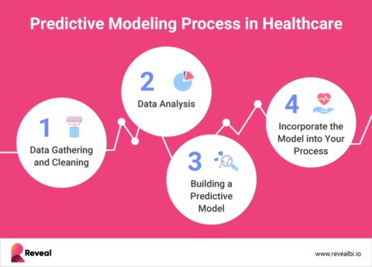
Methodology Data Processing Title: Building the Model: Data Preparation Key Points:
Large datasets processed in modular Jupyter Notebooks.
Intermediate outputs saved and merged by Month-Year & Location.
Spatial merging based on transformed latitude and longitude.
Final dataset split into 80% training and 20% testing
Key points:
Data cleaning
Data preprocessing
Merging
EDA
Data Splitting
Model fitting(Training)
Deployment (Streamlit)

Slide 6
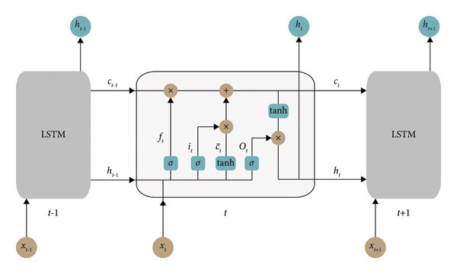
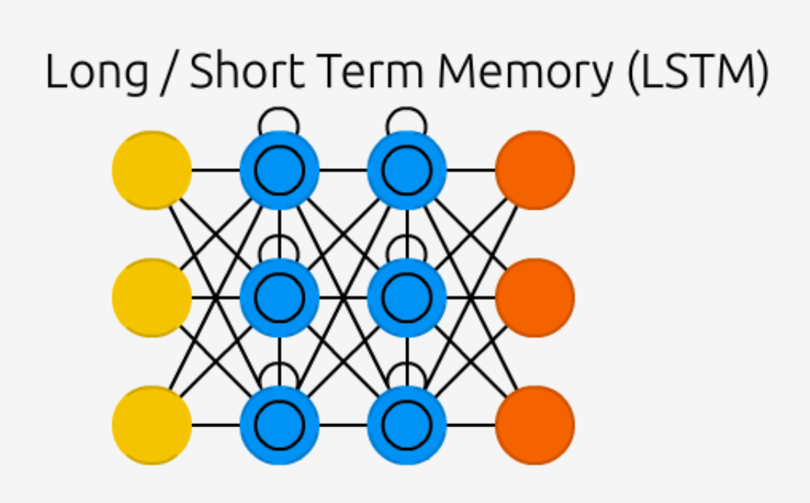
Methodology Model Selection Title: Choosing the Right Model Key
Critical need for accuracy, precision (avoid false positives), and recall (catch all outbreaks).
We chose a Long Short-Term Memory (LSTM) neural network, which is well-suited for analyzing sequential data like climate patterns and disease occurrences over time.
Explored other models like Random Forest, XGBoost, but found LSTM to be particularly effective at capturing temporal dependencies.
Evaluated tradeoffs in performance, complexity, and interpretability

Slide 7

Results and Findings Title: Key Outcomes Key Points
Performance metrics:
Accuracy: 0.97 (The model correctly predicts outbreaks and non-outbreaks 98% of the time).
AUC: 0.99 (The model has an excellent ability to distinguish between outbreak and non-outbreak scenarios).

Slide 8

Kindly locate the sections pertaining to data analysis and model deployment in the provided notebook and URL.
Deployment : https://diseaseoutbreakprediction-2vgkurhgb2gmpeeycdkvrj.streamlit.app/

